Slide 1

OPERATIONS
MANAGEMENT

Slide 2
Management Levels
Top Managers
Authority, Supervision, Leading, Directing Organizing, Controlling, etc.
Middle
Managers
Accountability, Reporting, Information sharing, Contributing, Suggesting, Following, etc.
First - Line
Managers
Non-managerial
Employees

Slide 3
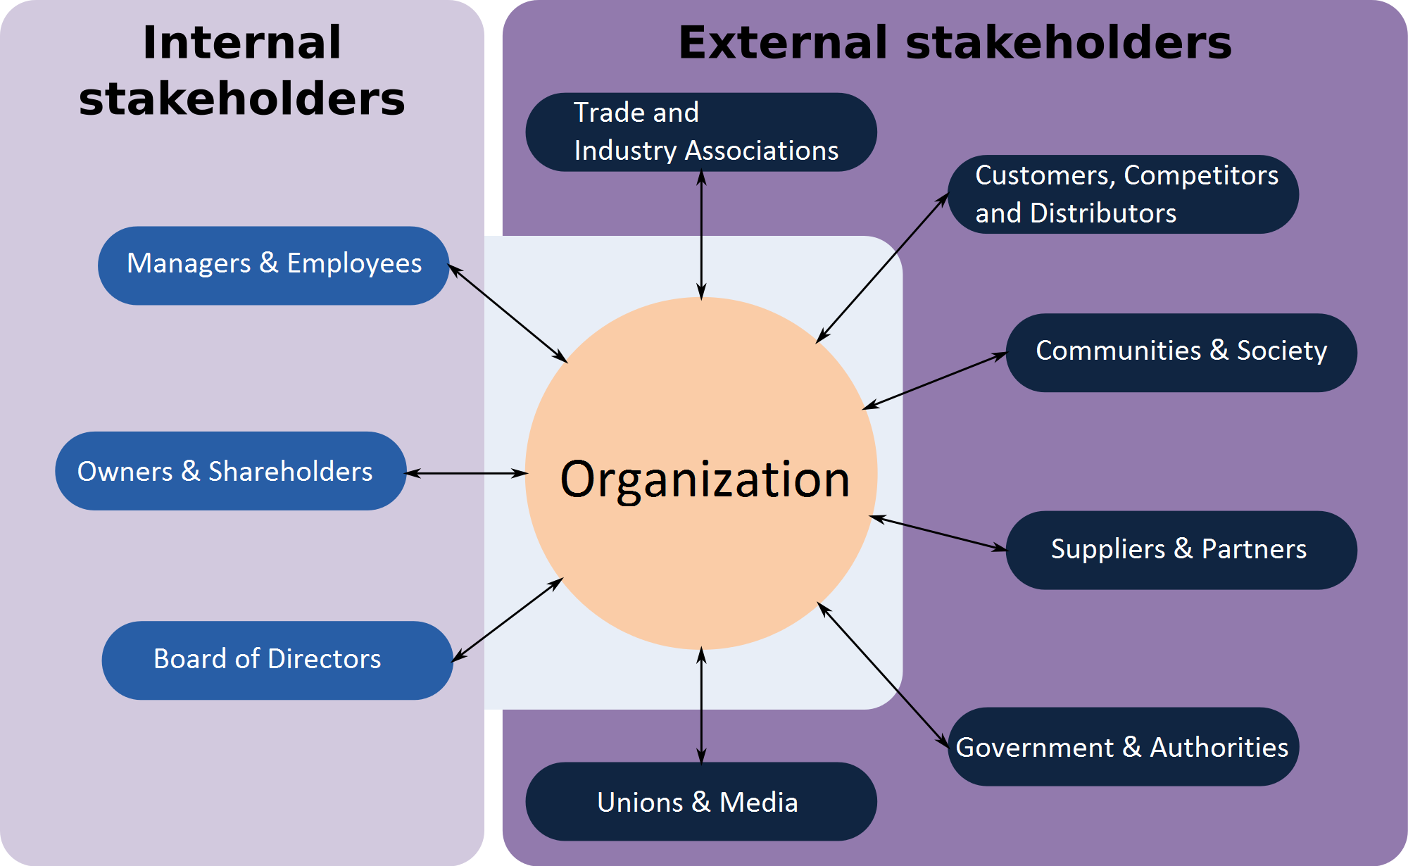
Organizational Stakeholders

Slide 4
What Is Operations Management?
Production is the creation of goods and services.
Operations management (OM) is the set of activities that create value in the form of goods and services by transforming inputs into outputs.

Slide 5
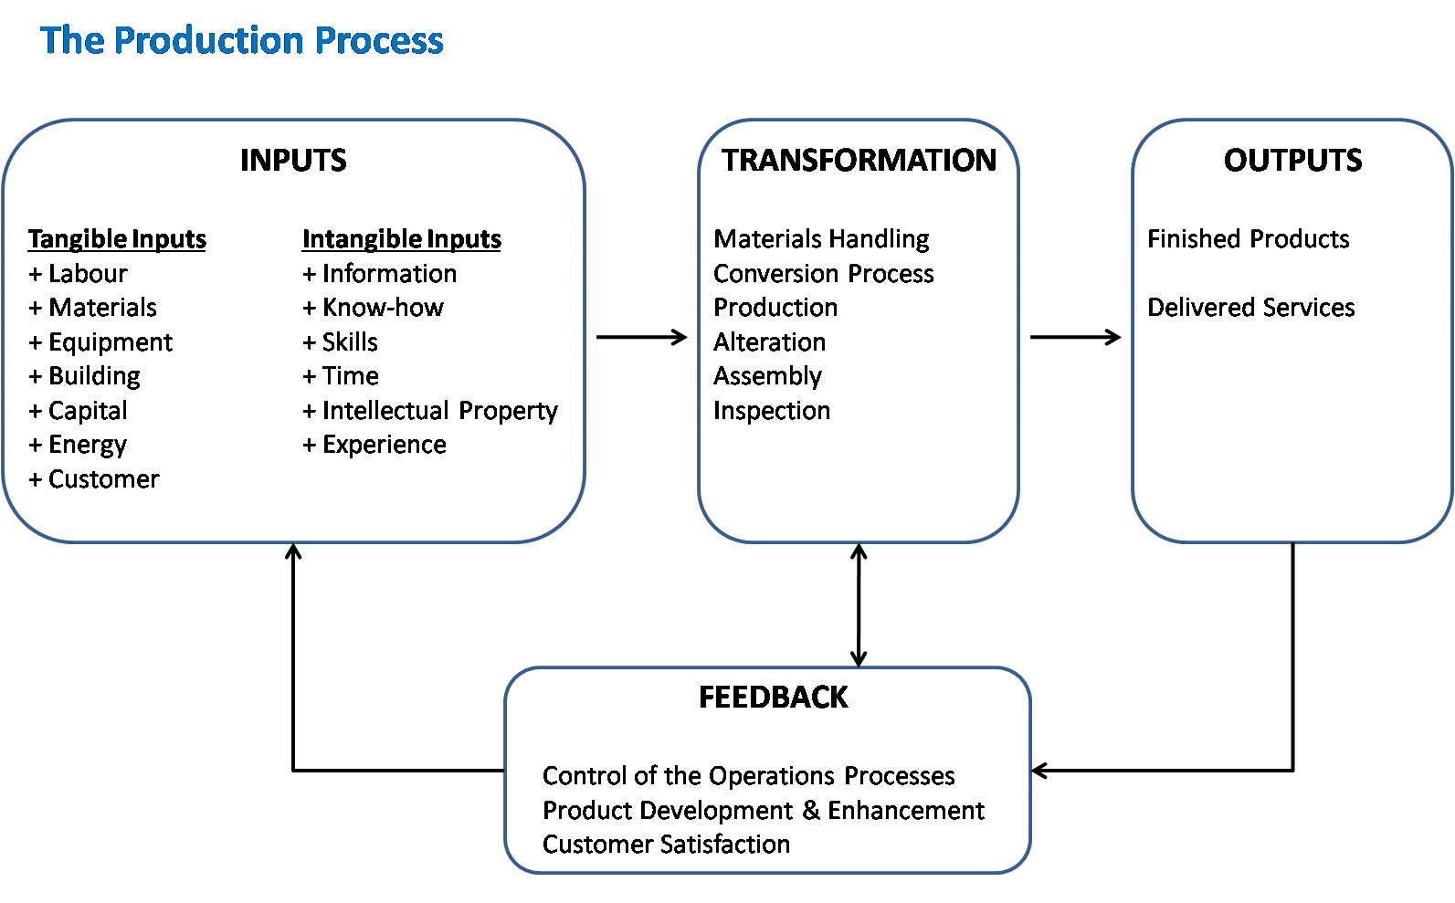

Slide 6
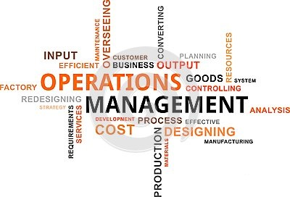

What Operations Managers do
Basic Management Functions
Planning
Organizing
Staffing
Leading
Controlling

Slide 7

Functions of Management
1) Planning entails creating & setting the organization’s goals and determining how best to achieve them. It involves a great deal of strategic decision-making and systematic thinking of the courses of actions, ways and means to fulfill the organization’s mission and make its vision a reality in the short, medium and long terms. Besides achieving the organization’s goals, with effective planning managers are more likely to ensure buy-in, get support, avoid confusion, and minimize risks, uncertainties and wastages.

Slide 8
Functions of Management
2) Organizing involves the efficient utilization of human and financial resources and other tangible & intangible assets in order to accomplish the plan in place. Work is divided into subtasks and milestones are set for achieving each subtask. Resources are allocated and responsibilities are given to the employees who are capable of coming through with their parts.
3) Staffing involves attracting, recruiting, selecting, training and retaining of employees. Managers need to hire and keep the right people with the right skills and attitude, for the right roles, at the right time.

Slide 9

Functions of Management
4) Leading entails influencing, guiding, coaching, directing and motivating employees, and facilitating constant communication and encouragement with them for the achievement of organizational goals.
"Customers will never love a company until the employees love it first."
Simon Sinek

Slide 10

Functions of Management
5) Controlling involves checking & monitoring activities and conducting assessments to ensure everything is going as planned. Managers may be in charge of controlling how well their employees, systems and processes etc. are performing, and they are also responsible for identifying underperformance issues and taking corrective action to improve performance and productivity.

Slide 11
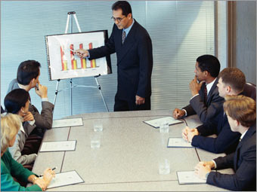
What Operations Managers do
Operations managers deal with the entire production process and work as an intermediary between the operations department and almost all the other departments in an organization.
Notes:
For example, marketing and sales department informs the operations department of the required number of units to be produced per demand; finance department authorizes the funding amount for the purchasing department to supply the materials or any other equipment needed for the operations department to finalize the production. When the end products are ready to be shipped, the operations department coordinates the delivery with the logistics and transportation department.

Slide 12
Organizing to Produce
Goods/ Services
Essential functions:
Marketing – generates demand
Production/operations – creates the product
Finance/accounting – tracks how well the organization is doing, pays bills, collects the money

Slide 13
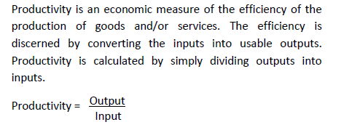

Productivity

Slide 14
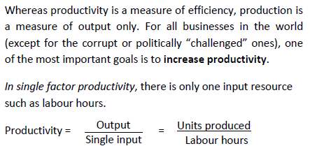

Productivity

Slide 15
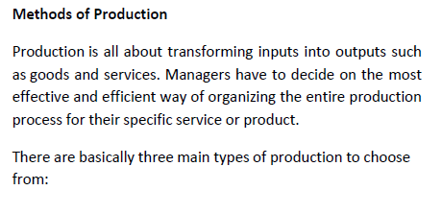
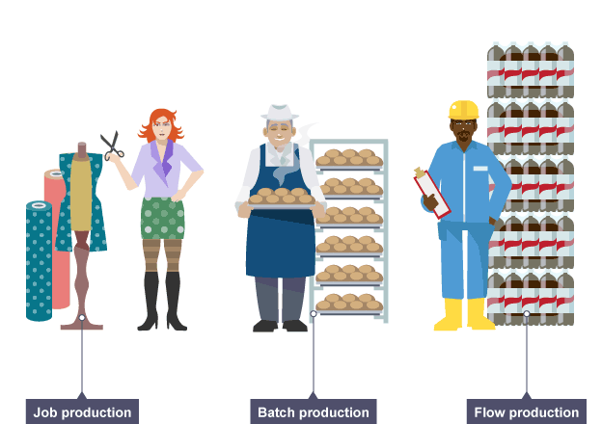

Slide 16
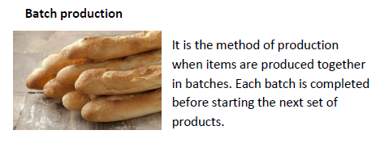
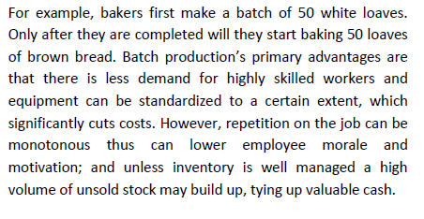
Methods of Production

Slide 17
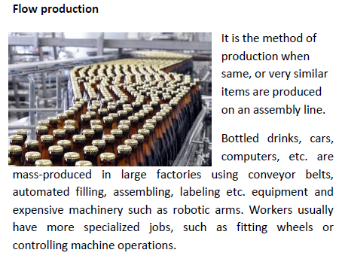
Methods of Production

Slide 18
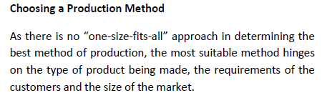

Methods of Production

Slide 19
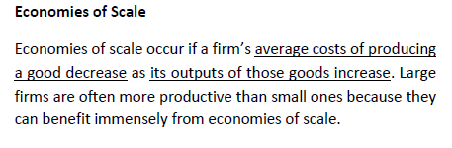


Slide 20
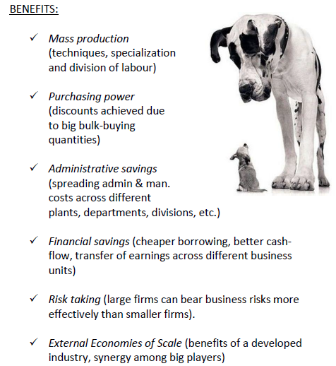
Economies of Scale

Slide 21
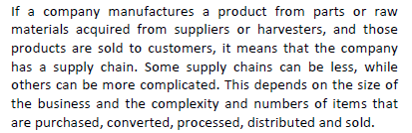





Supply Chain Management
Farmer Syrup Bottler Distributor Retailer
producer

Slide 22
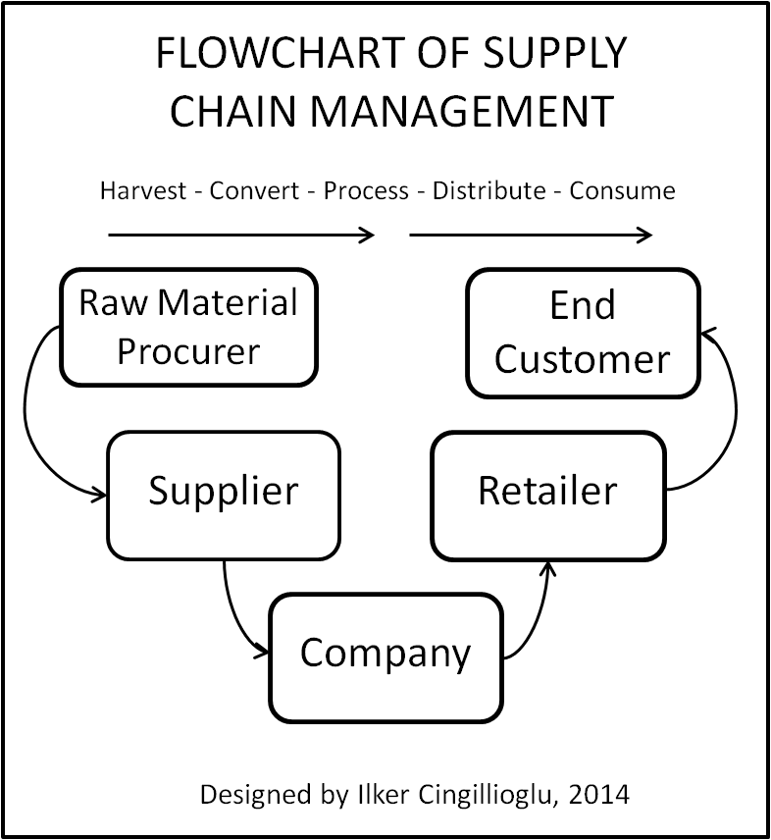

Slide 23
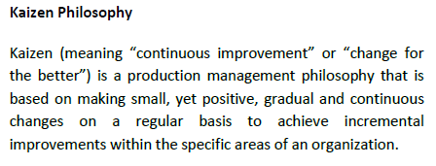
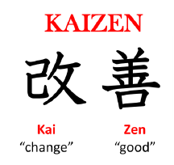

Slide 24

Managing Projects
Project Management is a disciplinary field that involves a methodical approach for planning, scheduling and controlling project processes from start to finish.

Slide 25


Examples of Projects
Building Construction
Research Project

